Slide 1

AI Heart Disease Prediction
and Risk Analysis
A Machine Learning & Deep Learning Based System
for Early Heart Disease Detection
Presented by
Naga Sai Kedasu & AR Fardin Shaik
2026

Slide 2


Problem Statement
17.9M
Why This Matters
Deaths per year from CVDs globally
Traditional diagnosis relies on manual assessment, which is time-consuming and error-prone.
AI-powered systems can analyze patient data and ECG images in seconds, enabling faster and more accurate early detection.
Early intervention can save millions of lives annually.
#1
Leading cause of death worldwide
80%
Of heart attacks are preventable

Slide 3




Project Objectives
01
Build an ML model to predict heart disease risk using clinical health indicators
02
Develop a CNN model for ECG image classification (Normal vs Abnormal)
03
Deploy an interactive web application using Streamlit for real-time predictions
04
Integrate an AI chatbot for personalized health guidance and recommendations

Slide 4





System Architecture
User Input
Preprocessing
ML / DL Models
Prediction
Chatbot
Health Data / ECG Image
Scaling, Encoding
SMOTE, Augmentation
Random Forest
CNN (ECG)
Risk % / ECG Class
PDF Report
AI-Powered
Health Guidance
End-to-End Pipeline: From Data Collection to AI-Driven Healthcare Insights

Slide 5


Dataset Overview
Heart Disease Dataset
ECG Dataset
CDC BRFSS 2022 Survey
MIT-BIH Arrhythmia Database
445,132 total records
87,554 training samples
40 original features → 15 selected
21,892 test samples
Target: HadHeartAttack (binary)
188 time-step signal features
Features: Age, BMI, Sleep, Smoking,
Diabetes, COPD, Depression, etc.
Binary: Normal vs Abnormal
Imbalanced classes (~6% positive)
Converted signals to images for CNN

Slide 6
Data Preprocessing Steps
1
Missing Values
2
Feature Selection
Handled NaN values by dropping incomplete rows; dataset reduced from 445K to 442K records
Selected 15 most relevant clinical features from 40 original columns based on domain knowledge
3
Feature Engineering
4
Encoding & Scaling
Created LifestyleRiskScore combining smoking, alcohol, and physical activity indicators
Applied One-Hot Encoding for categorical features and StandardScaler for normalization
5
Class Balancing
6
Train-Test Split
Used SMOTE (Synthetic Minority Over-sampling) to address severe class imbalance (~6% positive class)
80/20 stratified split preserving class distribution; random_state=42 for reproducibility

Slide 7
ML Model Comparison
Key Findings
Random Forest achieved highest accuracy at 84.8%
XGBoost led ROC-AUC score at 61.1%
Random Forest selected as primary model due to overall performance
SMOTE improved minority class recall significantly
Precision-recall tradeoff observed across all models

Slide 8
ECG Deep Learning Module
Input
224×224×3
Conv2D
32 filters
MaxPool
2×2
Conv2D
64 filters
MaxPool
2×2
Flatten
Dense
128
Output
Sigmoid
88%
Dataset:
MIT-BIH Arrhythmia (87,554 train / 21,892 test)
Architecture:
2-layer CNN with MaxPooling + Dense layers
Training:
15 epochs, Adam optimizer, Binary Crossentropy
Test Accuracy
Preprocessing:
ECG signals converted to 224×224 images
Output:
Binary classification: Normal / Abnormal

Slide 9
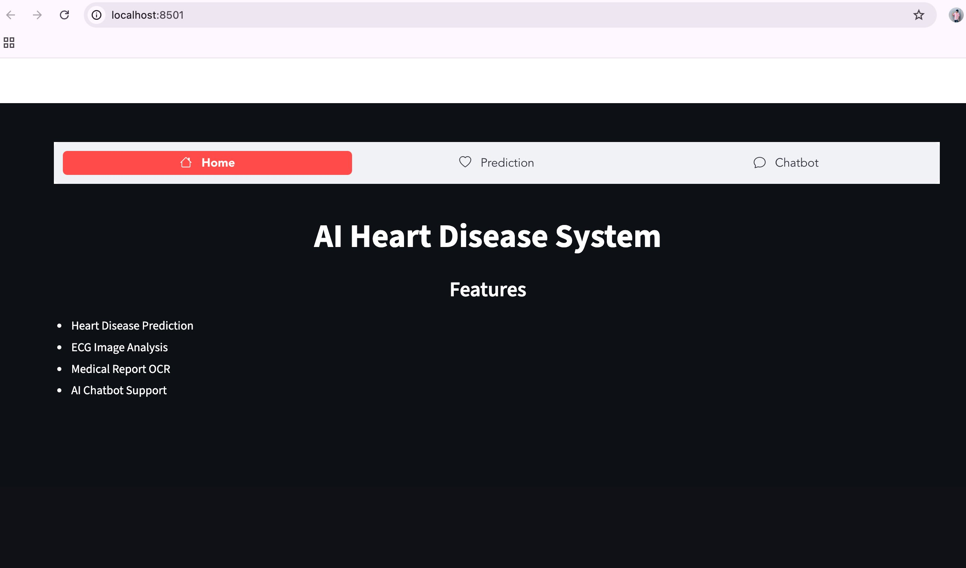
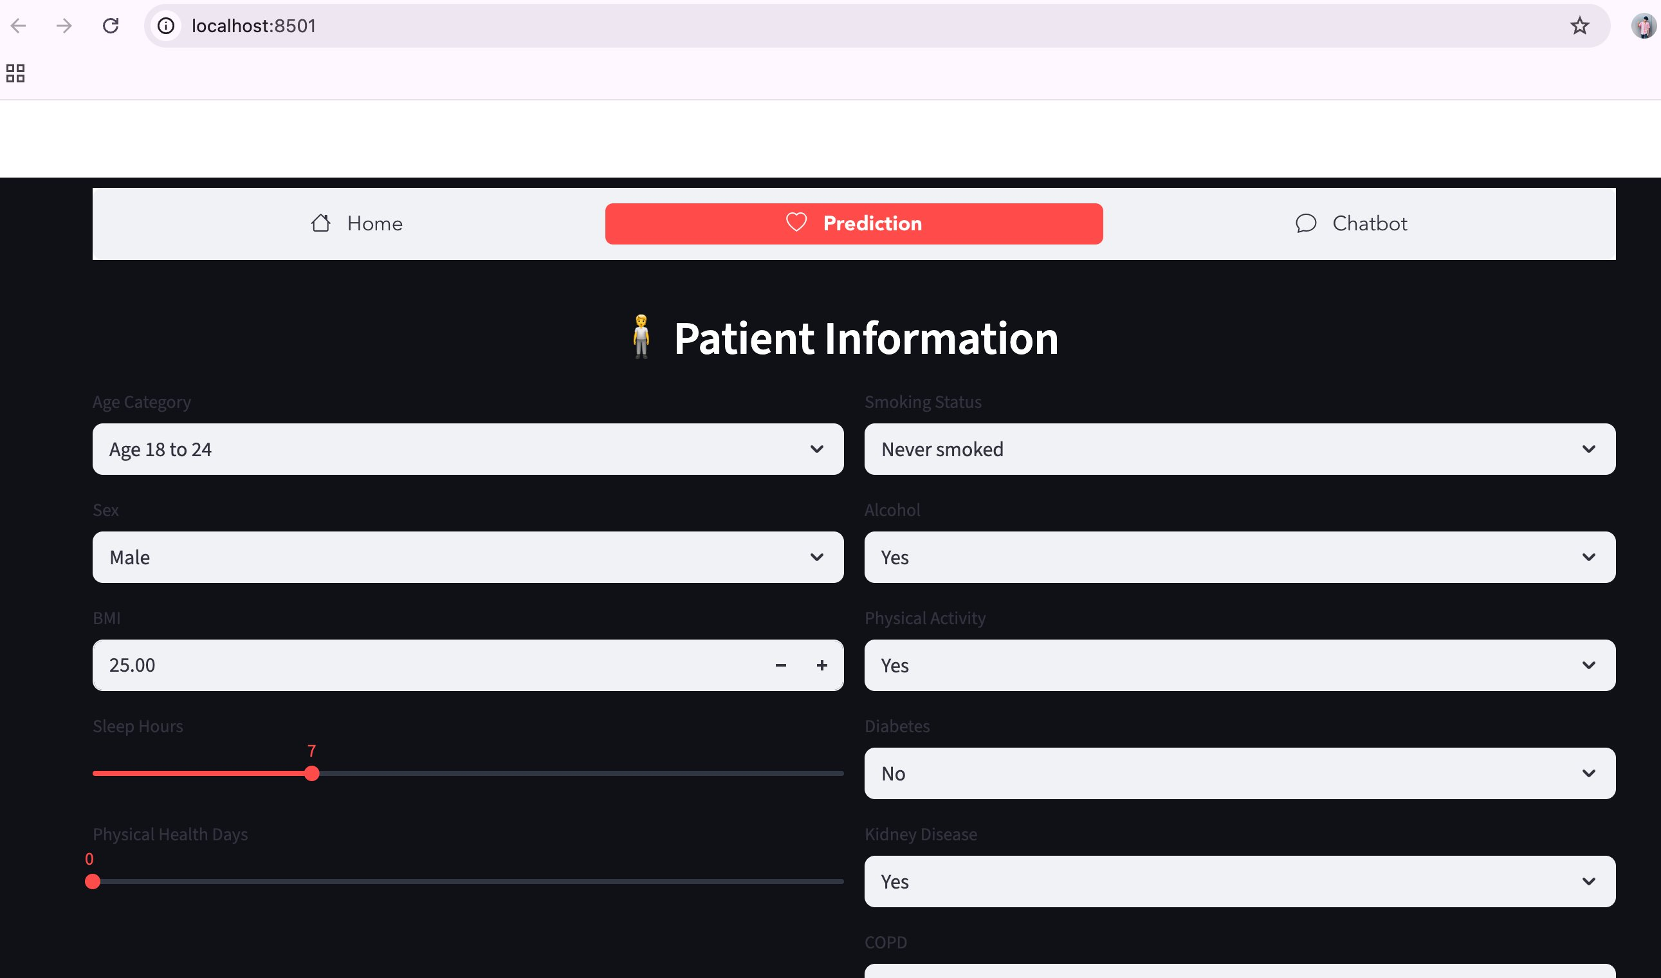
Streamlit Web Application
Home Page
Prediction Interface

Slide 10
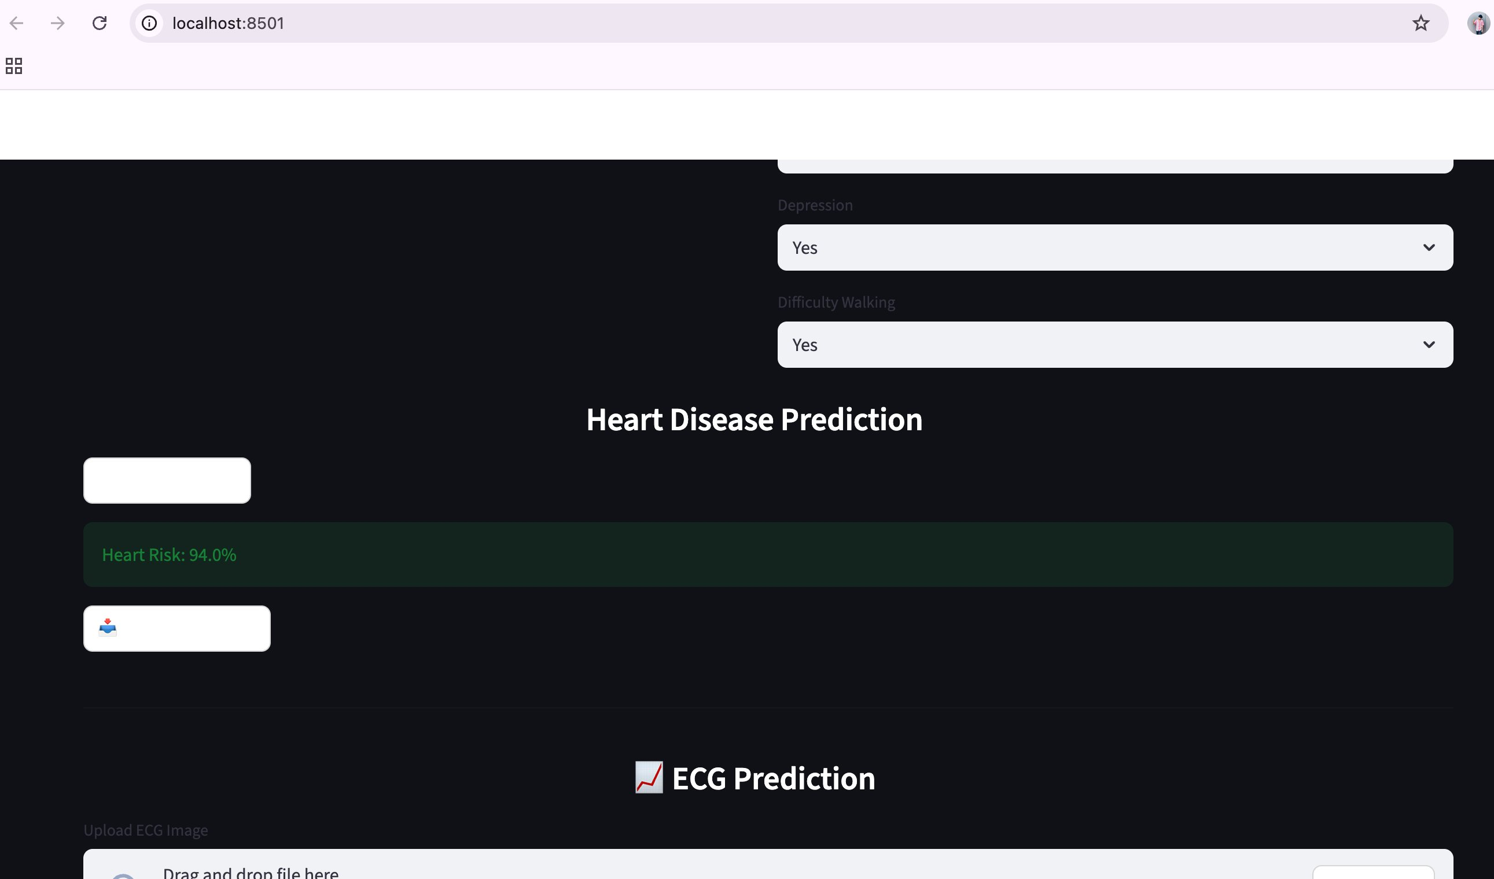
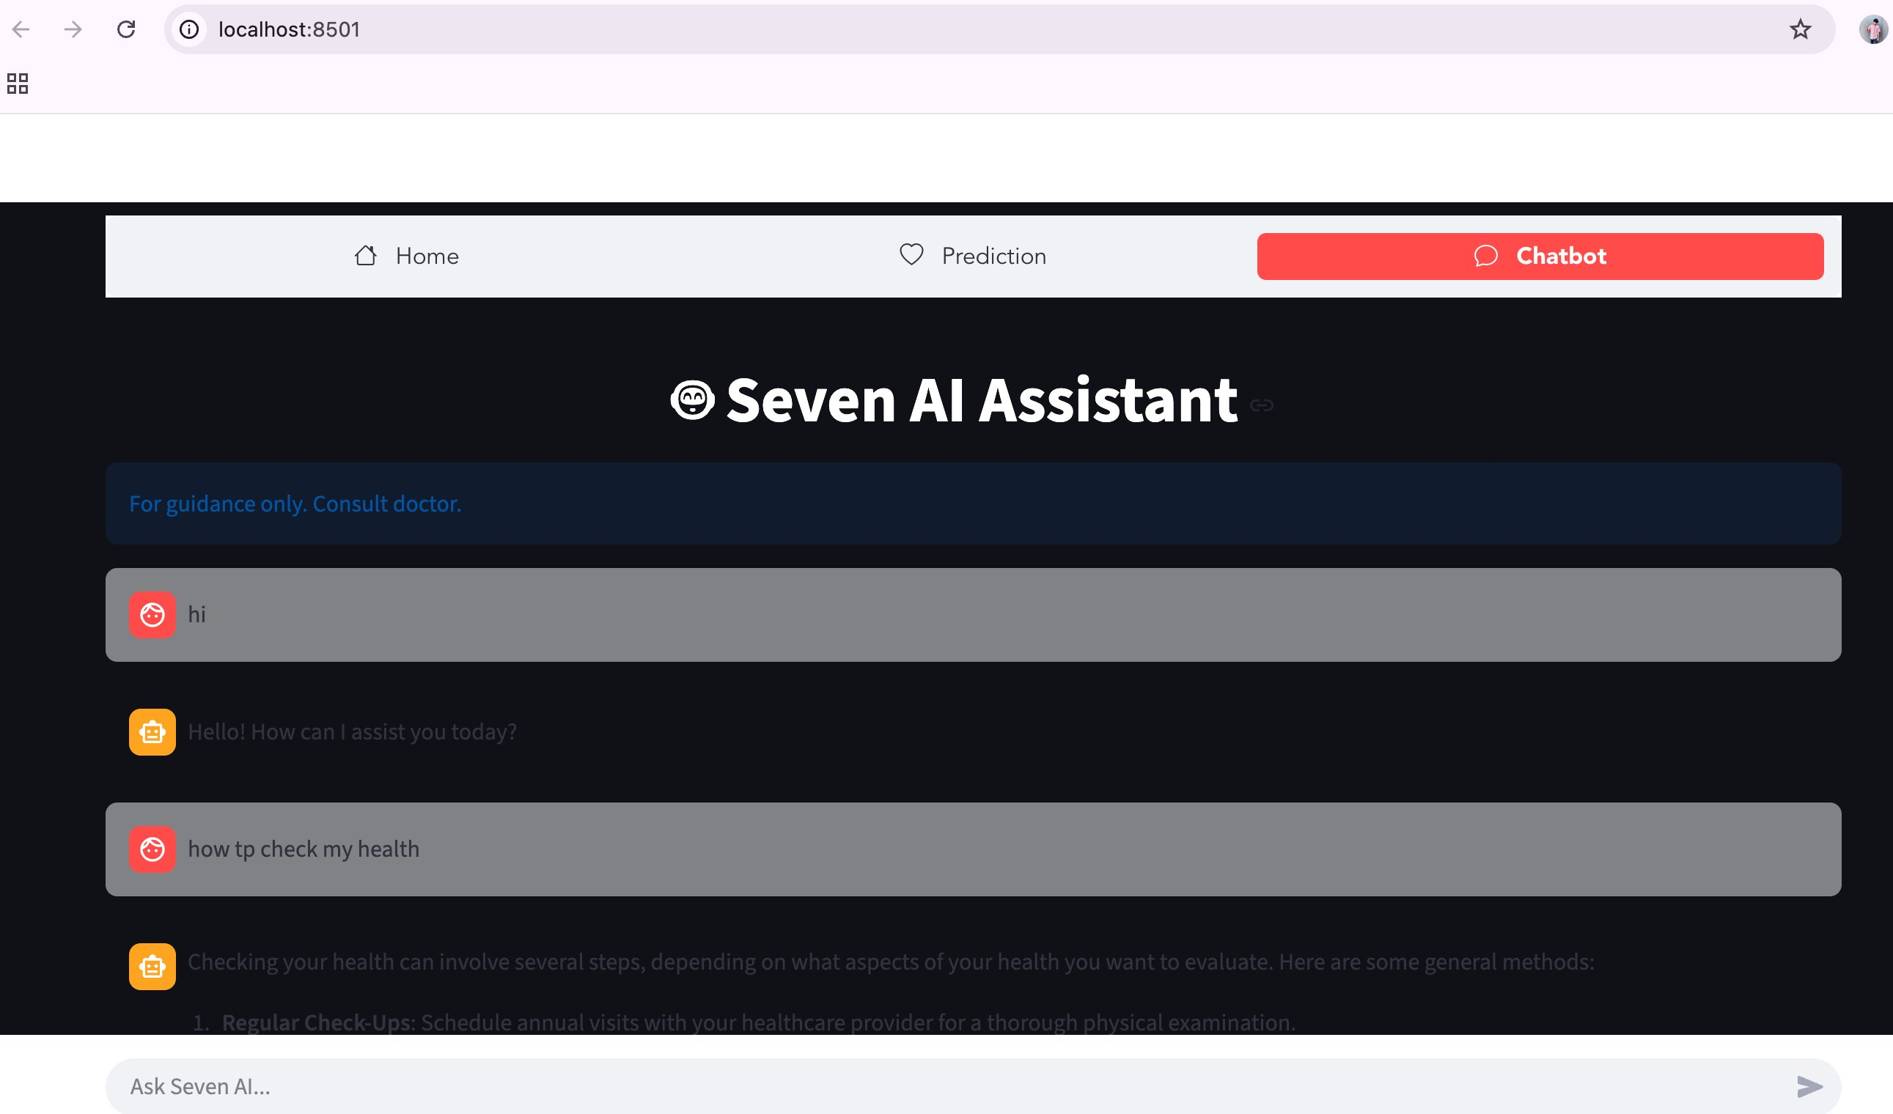
Prediction Results & AI Chatbot
Risk Assessment Output
Seven AI Chatbot

Slide 11

Technologies & Tools
Languages
ML Libraries
Deep Learning
Python 3.x
Scikit-learn, XGBoost,
IMBLearn (SMOTE)
TensorFlow / Keras
CNN Architecture
Web Framework
Data Processing
AI Integration
Streamlit
Streamlit Option Menu
Pandas, NumPy
OpenCV, Pillow
OpenAI GPT-4o-mini
Chatbot Assistant

Slide 12

Results Summary
Model | Accuracy | ROC-AUC | Precision (1) | Recall (1) | F1-Score (1)
Logistic Regression | 75.6% | 60.9% | 0.12 | 0.44 | 0.19
Random Forest ★ | 84.8% | 53.9% | 0.10 | 0.19 | 0.13
XGBoost | 76.8% | 61.1% | 0.12 | 0.43 | 0.19
CNN (ECG) | 88% | — | — | — | —
Analysis Insights
Random Forest achieved the best overall accuracy (84.8%) but with lower ROC-AUC, indicating a bias toward the majority class. XGBoost provided the best balance between sensitivity and specificity. The CNN model for ECG classification achieved 88% accuracy, demonstrating the effectiveness of deep learning for signal-based diagnosis.

Slide 13

Conclusion & Future Work
Conclusion
Future Scope
Successfully developed a dual-model AI system for heart disease prediction
Integrate real-time ECG monitoring from wearable devices
ML model provides risk assessment from clinical health indicators
Add more ML algorithms (SVM, KNN, Neural Networks) for comparison
CNN model classifies ECG images with 88% accuracy
Expand to multi-class heart disease classification
Interactive Streamlit application deployed with real-time predictions
Implement federated learning for privacy-preserving predictions
AI chatbot enhances user experience with guided health insights
Build a mobile application for broader accessibility

Slide 14

Thank You
Questions & Discussion

